Slide 1
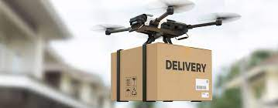
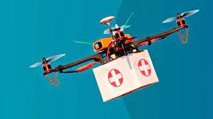
DRONE DELIVERY

Slide 2
Introduction:
One of the main benefits of using drones for last mile delivery is that they can reduce the time and cost of delivering goods to customers. Drones can fly over obstacles , avoid congestion and take shorter routes than conventional vehicles.
It is often the most costly and inefficient part of the distribution network due to factors such as traffic, distance, customer availability. This is improve customer satisfaction , reduce carbon emission and save fuel and labor costs.

Slide 3
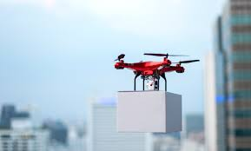
Why I m selecting
Why ??
Major reason potential to reduce CO (carbon monoxide) and other gases emission to reduce global warming.
Faster Delivery
3. Versatility : Drones can access remote or difficult –to-reach areas, expanding delivery capabilities.
4. No pollution

Slide 4
SWOT Analysis
Strengths
Cost Savings
Environmental Impact
Versatility
Data Collection
Efficiency
Weaknesses
Regulatory Challenges
Technology
Initial Investment
Limited Payload.
Opportunities
1. Market Expansion
2. Diverse Applications
3. Partnership
4. Data Analytics
5. Competitive Advantage
Threats
1. Regulatory Changes
2. Competitive Landscape
3. Security Risks
4. Public Perception
5. Technical Challenges

Slide 5
Flow chart
Food ready by restaurant
Load package into drone
Get order details from customer mobile app
Place order and received by restaurant
Check drone availability
Customer conformation before drone flight
Start preparing food
Order pickup by drone
Deliver to customer

Slide 6
Analysis
City selected for implementation of drone delivery Nashik
Factors
Drone Specification
Delivery parameter
increases | Every year (%)
Rent | 9
Electricity | 6
Battery | 2
Marketing | 15
Salary | 10
About Drone | Value
Flying range | 7 km
Flying attitude | 300 ft
Cost of one drone | 130000 INR
Avg. battery life | 03 months
Monthly maintenance cost | 6500 INR
Cost of one battery | 13000 INR
About drone | numbers
Food prep time | 20 min
Avg. drone speed | 40 kmph
Travel time per km | 1.5 min/km
Delivery charges for customer | 12 INR
Incentives for delivery agent | 55 INR
Avg delivery charges | 40 INR

Slide 7
Cost and Profit Revenue Breakdown
Starting costing No. of drones :880 Stock drones :120 Total drones :1000 Cost of one drones :1,30,000 Total Investment 13.cr Compound capital at 6% for 5 years 17.50 cr | Variable Cost Maintenance cost :8-10 cr Battery replacement :4-6 cr Marketing :4-5 lakh Electricity :22-25 lakh Total variable cost year 13-15 cr | fixed Cost Rent :2cr Salary :3cr License :2cr Broadband charges :1,30,000 Software charges :2lakh Total fixed cost year 10-12 cr
Net profit = Revenue – (Variable cost + fixed cost ) Final profit = Net profit – Initial investment

Slide 8
Graphical Representation
We got losses 1st 2 years after that we increases the profit.
In this graph there is net profit vs variable
In this graph orders are increases yeae to year

Slide 9
Pros | Cons
Time saving & fast delivery | Limited Range
Less chances for late delivery & improves accuracy in delivery | Can’t carry heavy weight
Using shorter & direct routes | Dangerous neat to Airports & Military Areas
Environment Friendly | Drone delivery is vulnerable to weather
Low operational charges compare to vehicle services, Reduce Operational Costs | Wildlife Issues
Promotes Tertiary Businesses | Expensive Device & Defective

Slide 10
Conclusion
Cost Savings
Environmental Impact
Versatility
Data Collection
Efficiency
6. Market Expansion
7. Diverse Applications

